Slide 1





Estimating Seasonal Behavior States from Bio-logging Sensor Data
Josh M. London
Devin S. Johnson, Paul B. Conn, Brett T. McClintock, Michael F. Cameron, and Peter L. Boveng
@jomilo75
jmlondon
josh.london@noaa.gov
NMFS Research Permit: 15126
ALASKA FISHERIES SCIENCE CENTER
Notes:
BOEM and NOAA Fisheries for supporting the data collection and analysis

Slide 2
Please cite this presentation as:
London, Josh M., D.S. Johnson, P.B. Conn, B.T. McClintock, M.F. Cameron, and P.L. Boveng (2015, December). Estimating Seasonal Behavior States from Bio-Logging Sensor Data. Oral presentation at the 22nd Biennial Conference on the Biology of Marine Mammals. San Francisco, California, USA. 10.6084/m9.figshare.2057928
ALASKA FISHERIES SCIENCE CENTER

Slide 3
The Importance of Seasons
The seasonal timing of key, annual life history events is an important component of many species' ecology.
ALASKA FISHERIES SCIENCE CENTER

Slide 4
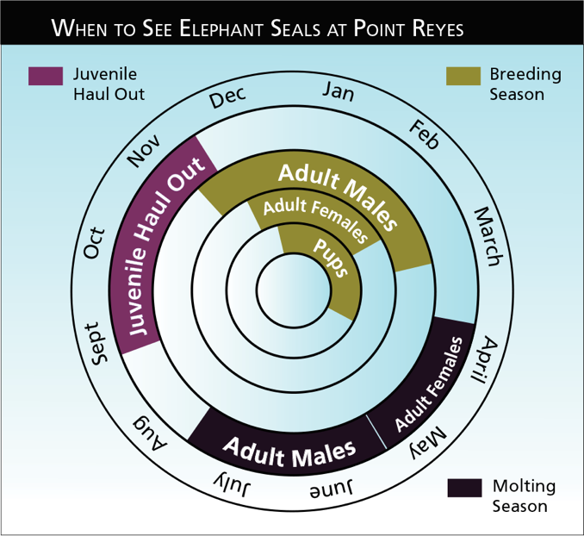
The Importance of Seasons
The timing of key life history events is well documented only for species found in accessible rookeries, breeding areas, or migratory corridors.
Point Reyes National Seashore, National Park Service
ALASKA FISHERIES SCIENCE CENTER
Notes:
Elephant seal calendar
Accessibility = better understanding

Slide 5
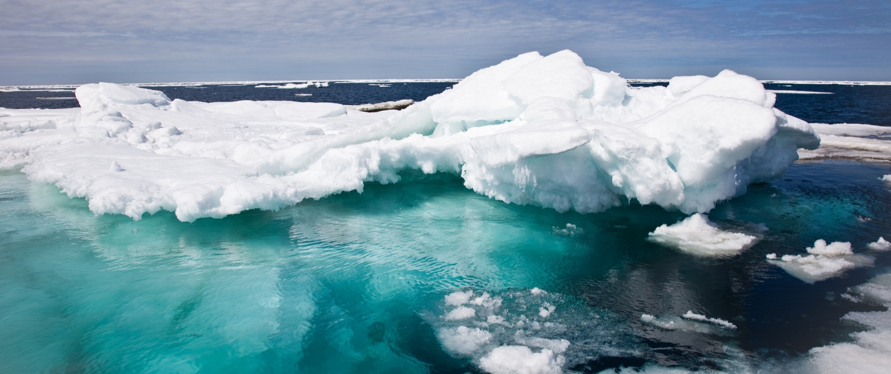
Our knowledge of seasonal timing for species widely dispersed in inaccessible or remote habitats is poor.
ALASKA FISHERIES SCIENCE CENTER
Notes:
This is especially true in the polar regions

Slide 6
Expected Change in Arctic Species
Key life-history events in Arctic species are often closely tied to sea-ice, weather, ocean productivity, and a range of other factors predicted to change dramatically
ALASKA FISHERIES SCIENCE CENTER
Notes:
For ice seals, pupping, breeding and molting are all linked to the presence of sea ice
For other Arctic species the productivity of spring blooms near the ice edge are critical

Slide 7

Seasonal Misalignment
Seasonal periods important to marine mammals often do not align well with typical labels.
ALASKA FISHERIES SCIENCE CENTER
Notes:
When we lack information on seasons, we tend to assign more human-centric definitions

Slide 8
Data From Bio-loggers
Fine-scale observations
Deployment lengths of several months
Record both movement and behavior
Data can be noisy
Large datasets
Position Error
Irregular in Time
Missing Data
ALASKA FISHERIES SCIENCE CENTER

Slide 9
Hidden Markov Models
Pattern recognition in noisy time series
Previously used to identify behavioral states
(e.g. foraging, transit, resting)
Widely used; existing tools
Behavioral states are, typically, shorter time steps
Duration in a state is not dependent on time already spent in a state
ALASKA FISHERIES SCIENCE CENTER

Slide 10

Multivariate Hidden Semi-Markov
Photo Adapted From Ben Husmann
ALASKA FISHERIES SCIENCE CENTER

Slide 11
Multivariate Hidden Semi-Markov
Hidden Semi-Markov models allow an arbitrary sojourn distribution
R package mhsmm
Jared O'Connell, Soren Hojsgaard (2011). Hidden Semi Markov Models for Multiple Observation Sequences: The mhsmm Package for R. Journal of Statistical Software, 39(4), 1-22. URL http://www.jstatsoft.org/v39/i04/.
ALASKA FISHERIES SCIENCE CENTER

Slide 12
Animal Movement Model
Predict locations at regular time steps that align with behavioral observations
R package crawl
Devin S. Johnson (2015). crawl: Fit Continuous-Time Correlated Random Walk Models to Animal Movement Data. R package version 2.0 (development branch available on Github).
ALASKA FISHERIES SCIENCE CENTER

Slide 13
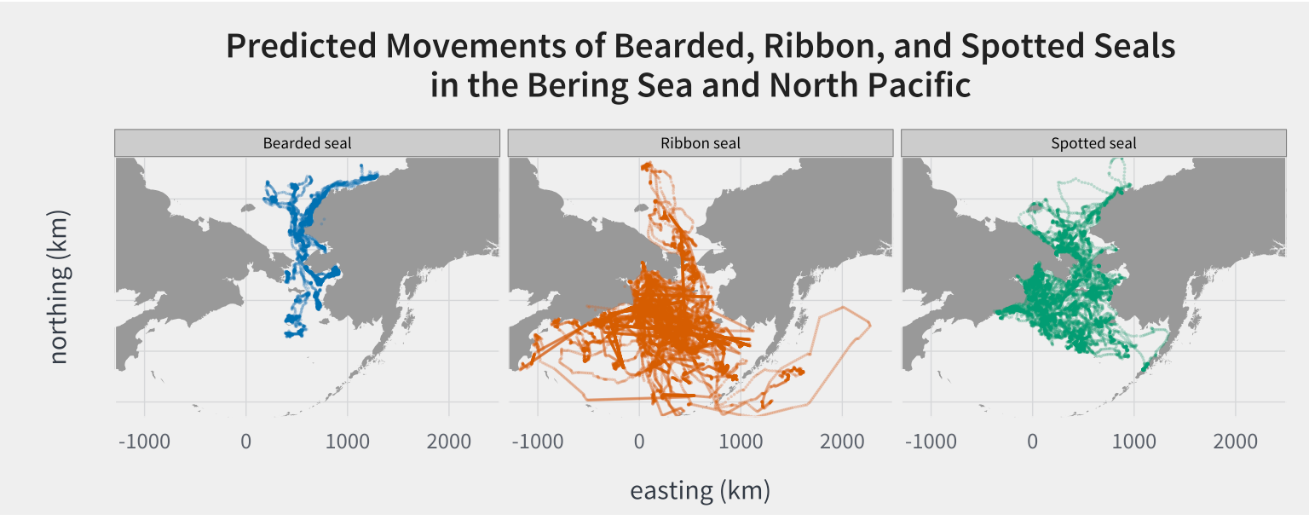
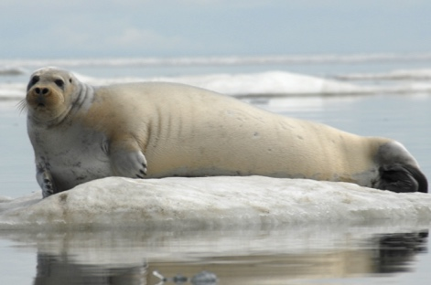
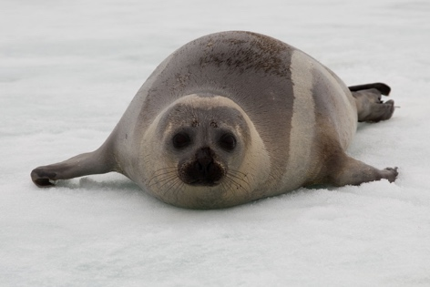
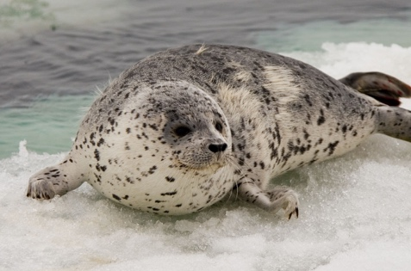
photo credit: John Jansen, Josh London
ALASKA FISHERIES SCIENCE CENTER

Slide 14
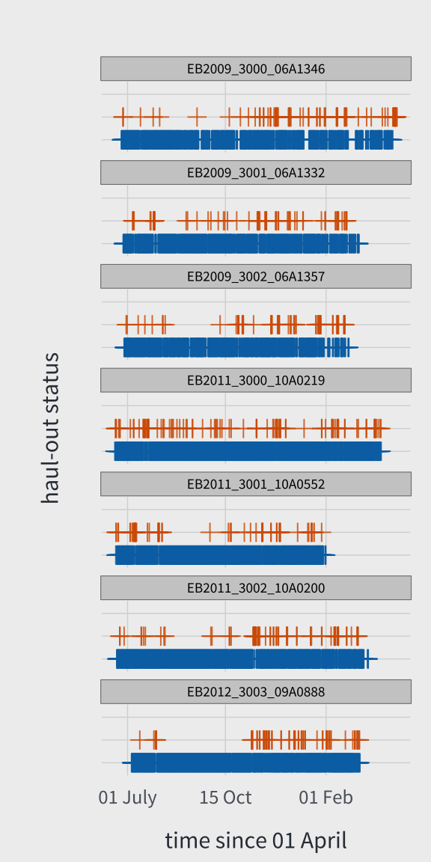
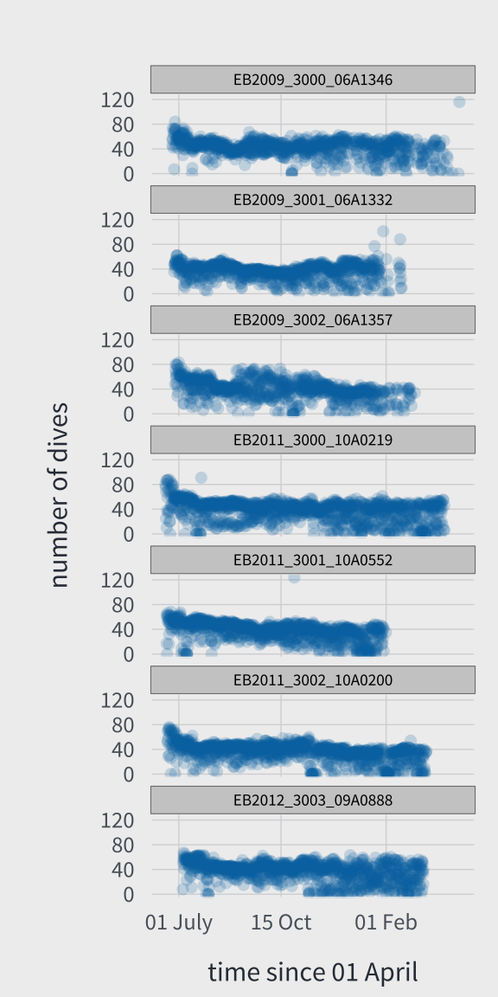
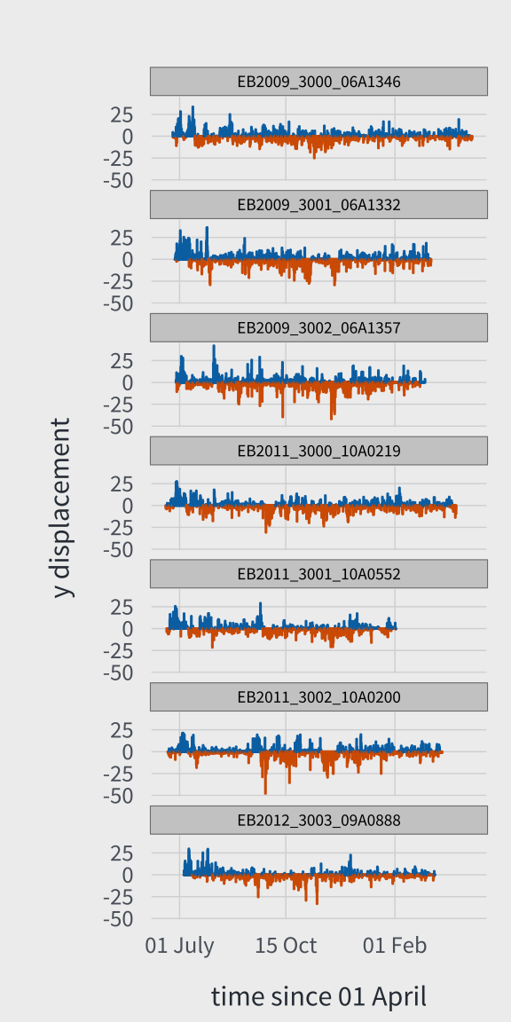
Notes:
Data from biologging sensors deployed on 7 adult bearded seals
Funding and collaboration with BOEM, coastal communities and Alaska natives

Slide 15
mhsmm Parameters
Haul-out status (6 hours)
Bernoulli (initial value: 0.1 for each state)
Number of Dives (6 hours)
Poisson (initial value: 30 for each state)
XY-Displacement (6 hours)
Multivariate Normal (initial value: 0,0; 20,20)
Sojourn Time
Poisson (initial value: mean = 150; shift by 200)
ALASKA FISHERIES SCIENCE CENTER
Notes:
Examined 2-7 states;
AIC and other evaluations led us to settle on 4

Slide 16
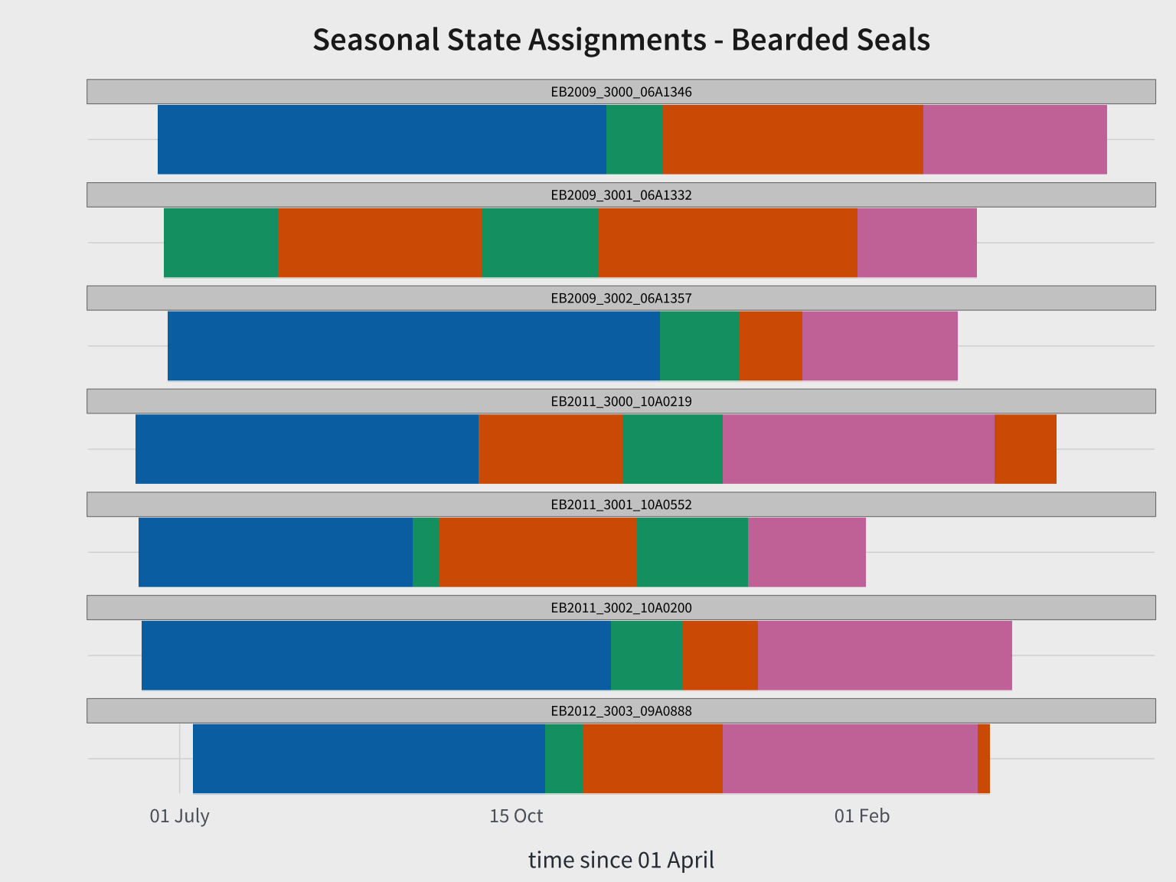

Slide 17
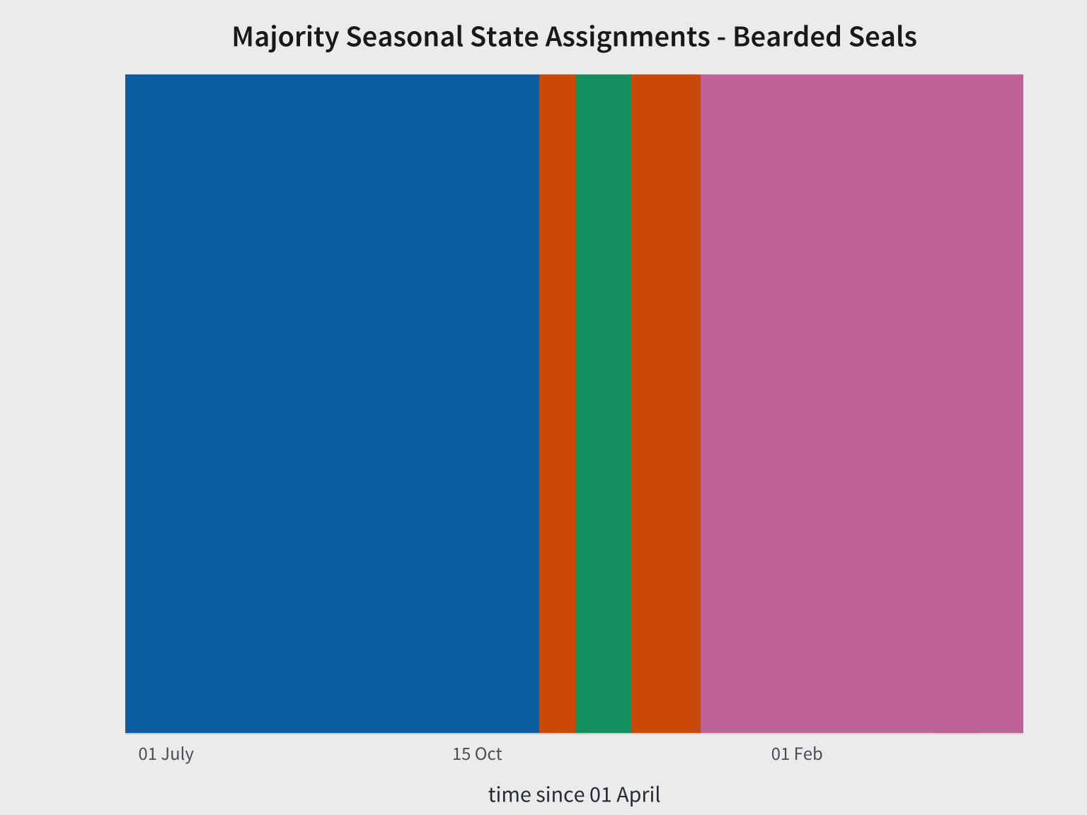
Notes:
Majority state at each time step

Slide 18
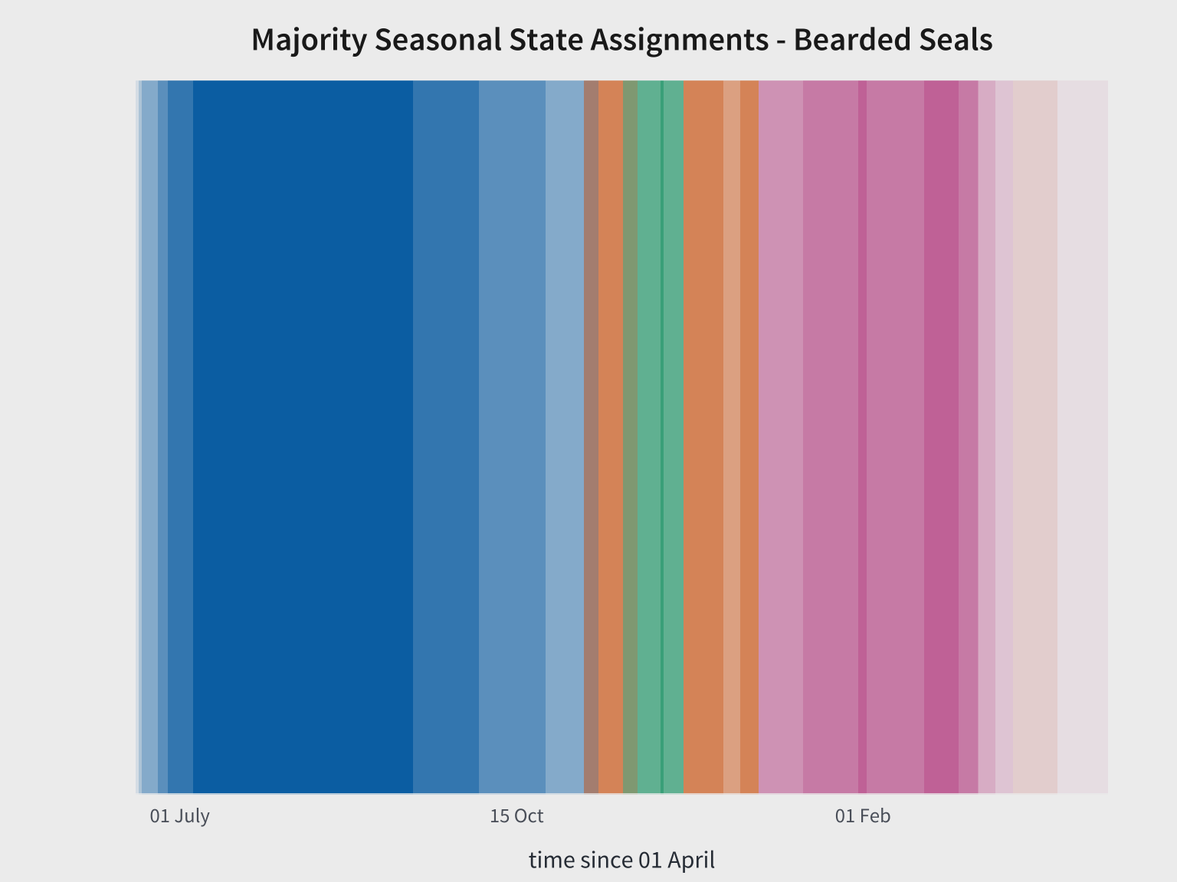
Notes:
Here we use transparency to represent the percentage of tags that were in the majority state

Slide 19
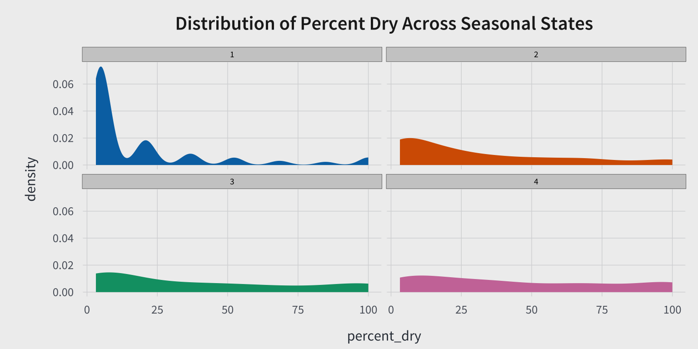
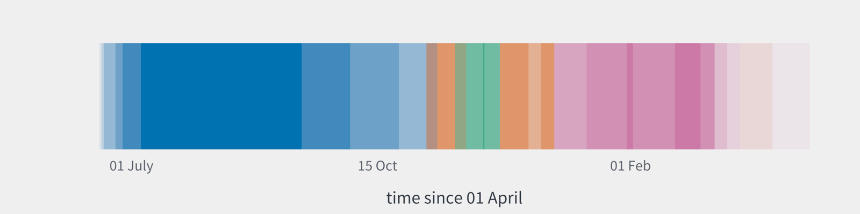

Slide 20
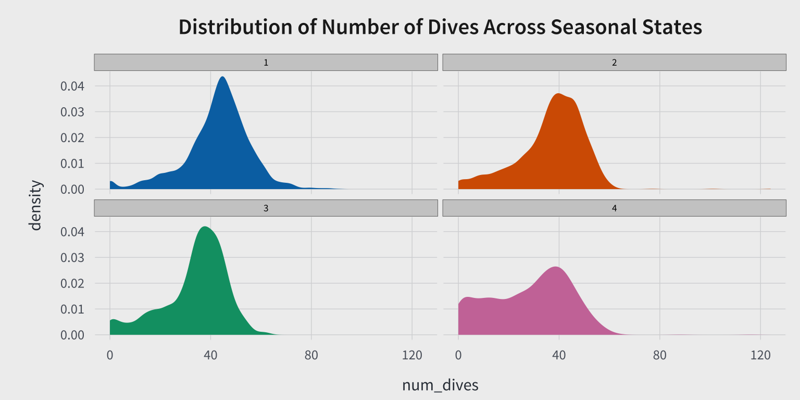

Slide 21
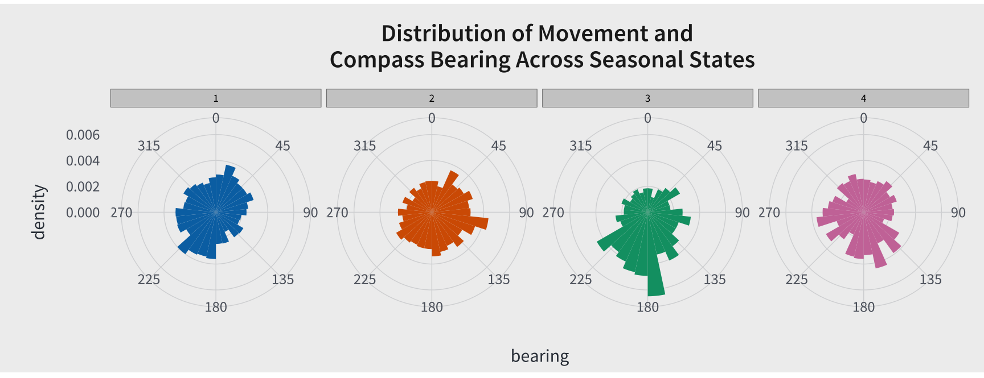

Slide 22
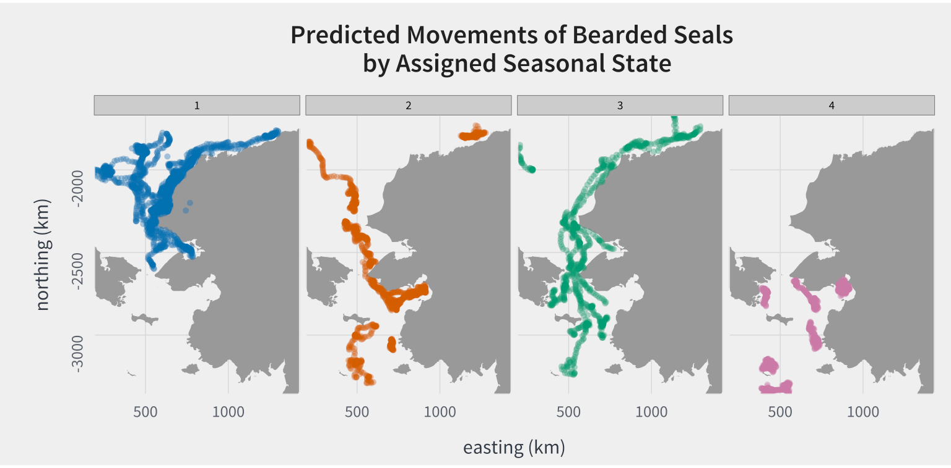

Slide 23
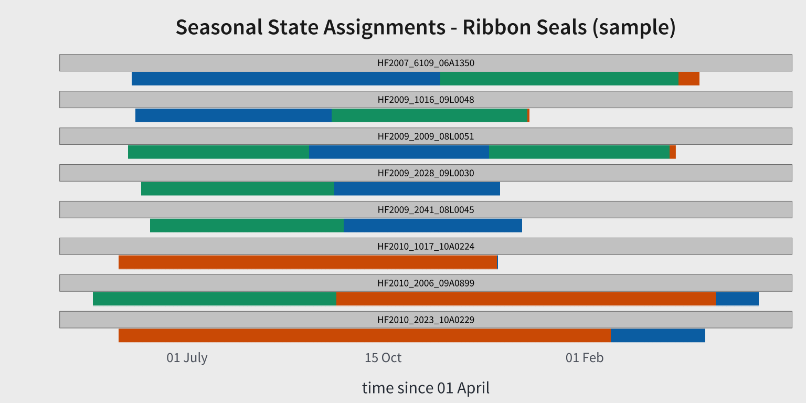
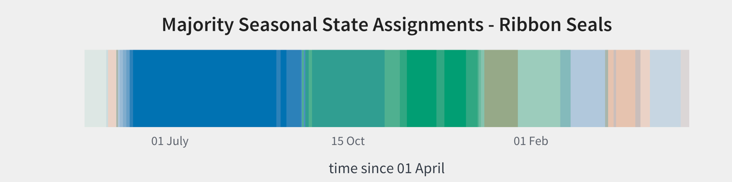
Notes:
Only 3 states
There is some indication of a seasonal pattern, but much more variability
The model is fairly unstable and will find a different solution each time

Slide 24
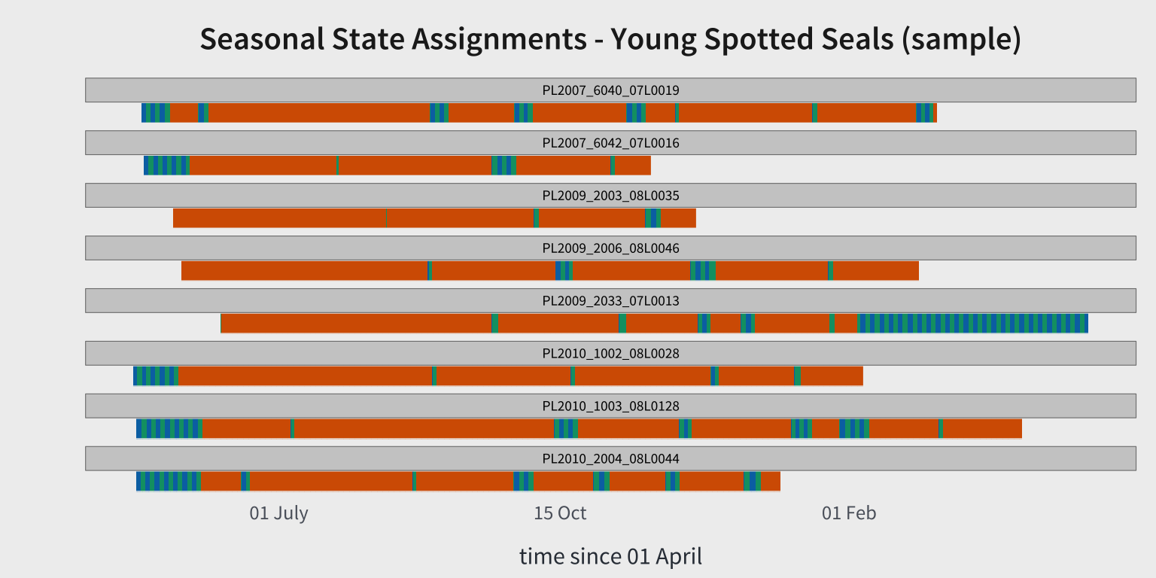
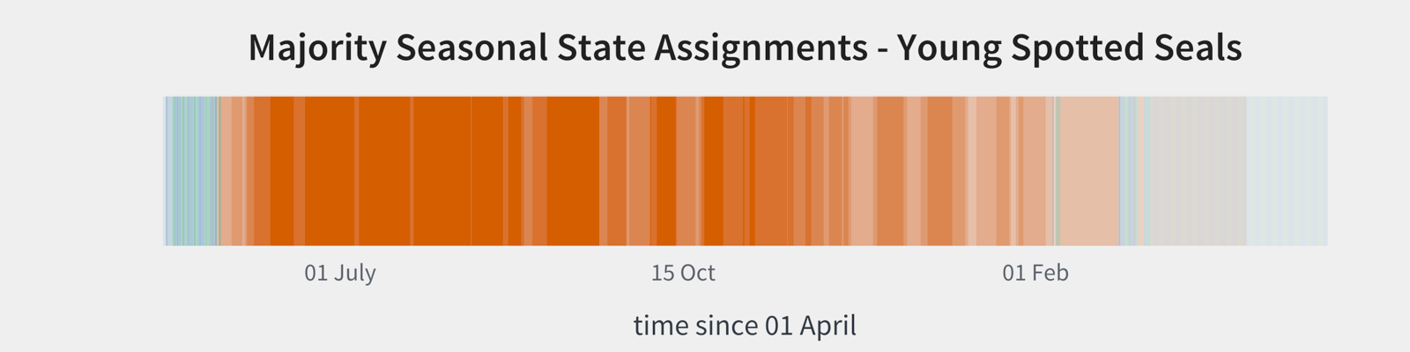
Notes:
Also unstable, but for a different reason.
There isn’t much of a seasonal signal; instead periods of time at sea with interspersed haul-out
Could be young animals are still learning and naïve to seasonal patterns

Slide 25
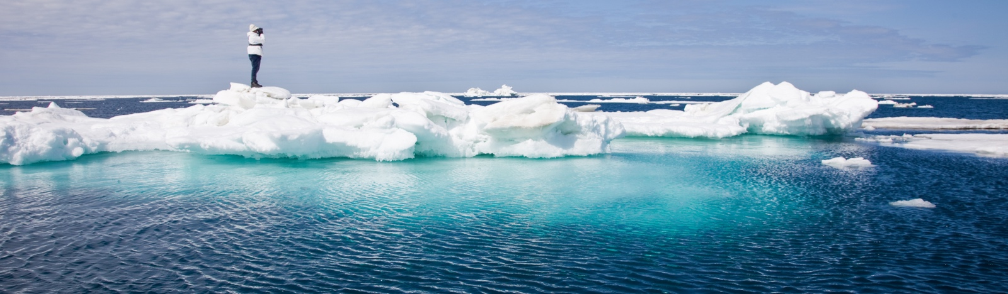
Bearded seal results tell a nice story and aligns with our understanding of their ecology
Ribbon and spotted seals remind us we still have more work to do
ALASKA FISHERIES SCIENCE CENTER

Slide 26
Future Considerations
Still just a ‘proof of concept’
Fix transition probabilities so they are one-way
Separate out individual heterogeneity
Explore other time steps for observations
Explore additional sensor data
ALASKA FISHERIES SCIENCE CENTER

Slide 27
Conclusions
Bio-logging provides our best insight into the seasonal timing of key life-history events
Could prove a useful tool for measuring change
ALASKA FISHERIES SCIENCE CENTER

Slide 28
DISCLAIMER
The scientific results and conclusions, as well as any views or opinions expressed herein, are those of the author(s) and do not necessarily reflect those of NOAA or the Department of Commerce
ALASKA FISHERIES SCIENCE CENTER

